Slide 1



Titolo presentazione sottotitolo
Simulation and Testing of Navigation for an Autonomous Mobile Robot
Tesi di Laurea Magistrale in Automation and Control Engineering – Ingegneria dell'Automazione
Author: Giovanni Porcellato
Milano, XX mese 20XX
Student ID: 10745779
Advisor: Prof. Matteo Matteucci
Co-advisor: Dr. Simone Mentasti
Academic Year: 2021-2022

Slide 2
Context
This work proposes a tool that responds to three different needs:
Test new navigation algorithms in a safe and prompt way
Build a testing module aimed at collecting navigation statistics and performance metrics for both internal development and commercial use
Solve reflective glares issue that lead to stuck navigation

Slide 3
Simulation Module

Slide 4
Testing Module

Slide 5
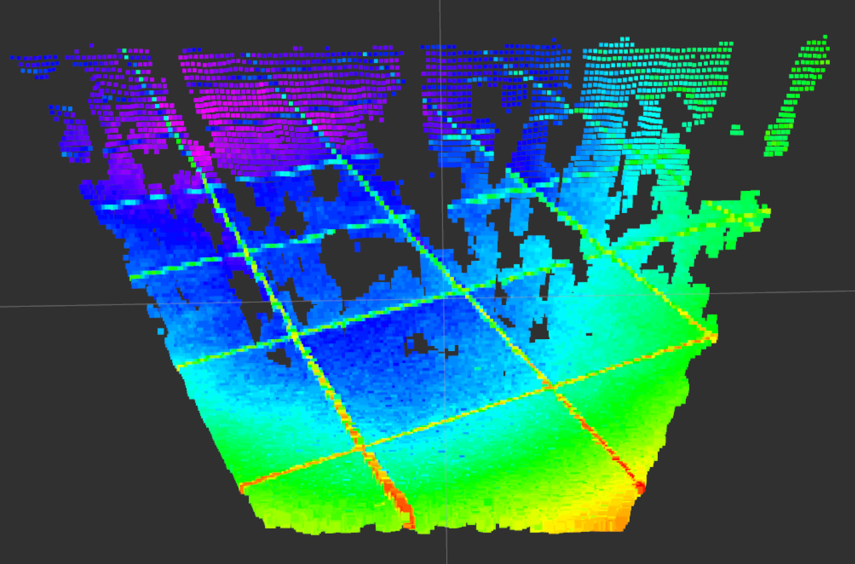
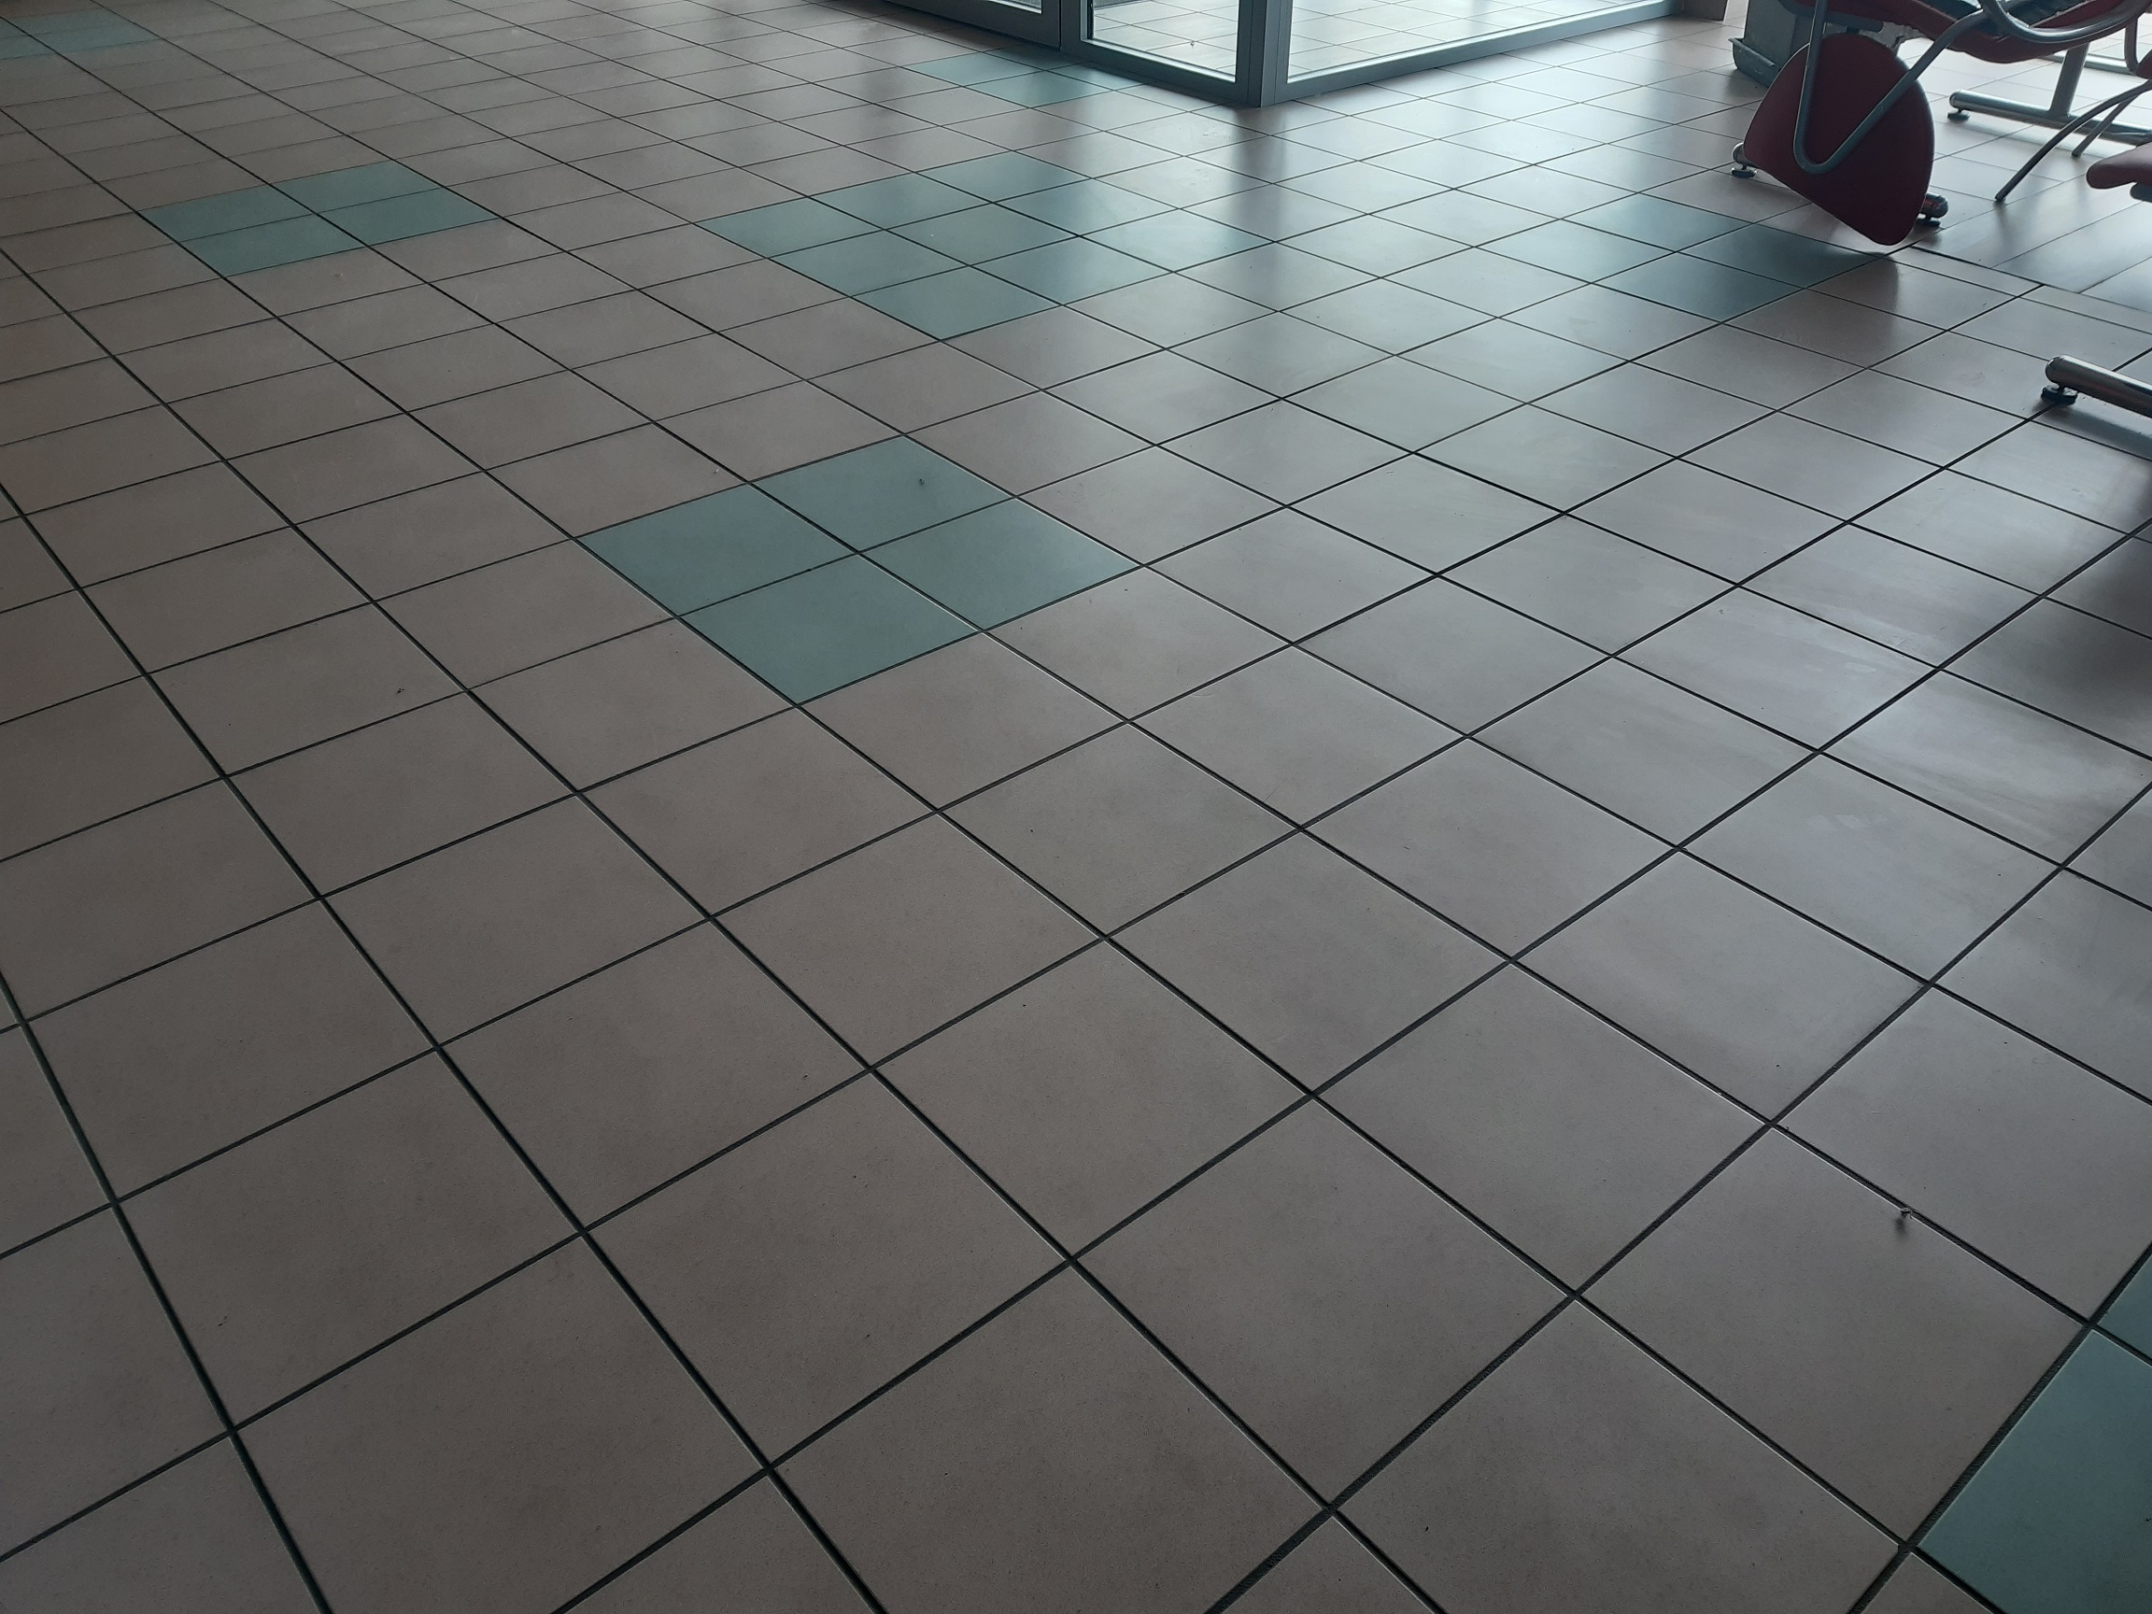
Pointcloud Filter
Issue: in certain particular indoor and/or outdoor environment conditions, the robot perceived phantom obstacles, which did not exist in reality

Slide 6
Pointcloud Filter
Issue: in certain particular indoor and/or outdoor environment conditions, the robot perceived phantom obstacles, which did not exist in reality
Consequence: if the local planner encounters these phantom obstacles: a great deal of time is lost and the robot travels a greater distance, also resulting in greater energy consumption

Slide 7
Pointcloud Filter
Issue: in certain particular indoor and/or outdoor environment conditions, the robot perceived phantom obstacles, which did not exist in reality
Consequence: if the local planner encounters these phantom obstacles: a great deal of time is lost and the robot travels a greater distance, also resulting in greater energy consumption
Solution: consider reflections as a data message that is too dense to be analyzed. Remove noisy measurements from the pointcloud, as these scattered outliers corrupt the results. The solution therefore proposes statistical analysis around each point neighborhood.

